Slide 1

NLP Albumentation
ISM 6930 - Prior Work & Data Sourcing
By
Shailendra Singh & Enock Chemochek

Slide 2

Agenda
INTRODUCTION
PRIOR WORK
DATA SOURCING
WHAT’S NEXT

Slide 3

INTRODUCTION
Why need Augmentation?
Data collection is difficult and expensive
Insufficient data causes model underfitting, which leads to poor performance of model in real world
Data imbalance in classification leads to low accuracy and recall rate.
By obtaining more high-quality data, augmentation practices can help the model to improve its robustness.

Slide 4

Prior Work
Qiu, Siyuan, et al. "Easyaug: An automatic textual data augmentation platform for classification tasks." Companion Proceedings of the Web Conference 2020. 2020.
P. Liu, X. Wang, C. Xiang and W. Meng, "A Survey of Text Data Augmentation," 2020 International Conference on Computer Communication and Network Security (CCNS), 2020, pp. 191-195, doi: 10.1109/CCNS50731.2020.00049.
Issifu, A. M., & Ganiz, M. C. (2021). A simple data augmentation method to improve the performance of named entity recognition models in medical domain. 2021 6th International Conference on Computer Science and Engineering (UBMK). https://doi.org/10.1109/ubmk52708.2021.9558986
Papakipos, Z., & Bitton, J. (2022). AugLy: Data augmentations for adversarial robustness. 2022 IEEE/CVF Conference on Computer Vision and Pattern Recognition Workshops (CVPRW). https://doi.org/10.1109/cvprw56347.2022.00027

Slide 5
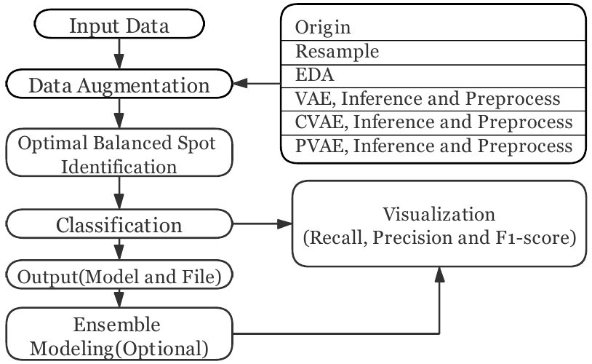
[1]. Qiu, Siyuan, et al. "Easyaug: An automatic textual data augmentation platform for classification tasks." Companion Proceedings of the Web Conference 2020. 2020.
Motivation
An augmentation approach that works on one dataset may not work on another.
Generative methods do not have evaluation tools co compare effectiveness.
Solution
Incorporate augmentation approaches and evaluate effectiveness of each model using EasyAug architecture.
Augmentation Approaches
Random-Resampling
World-level transformations
Variation Auto-Encoders (VAEs)
Ensembling (incorporates models such as BiLSTM, TextCNN, TextRCNN, and FastText)

Slide 6
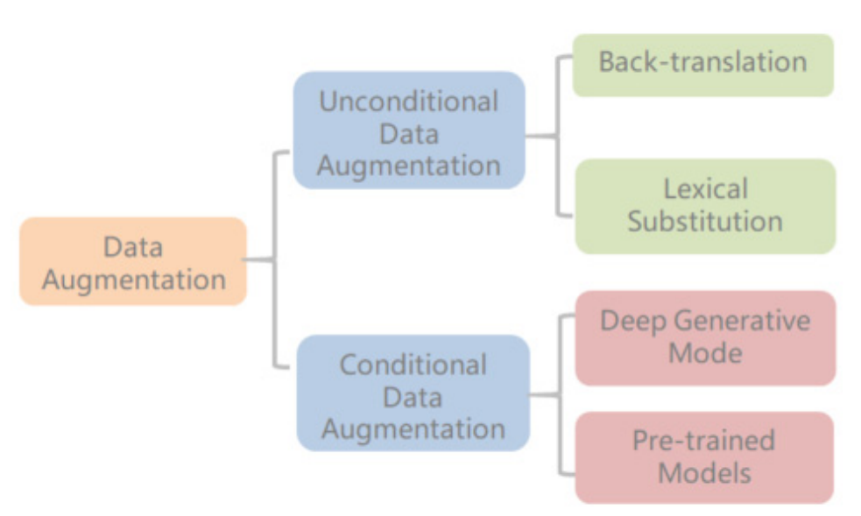
[2]. P. Liu, X. Wang, C. Xiang and W. Meng, "A Survey of Text Data Augmentation," 2020 International Conference on Computer Communication and Network Security (CCNS), 2020, pp. 191-195, doi: 10.1109/CCNS50731.2020.00049.
Inspiration
Inspired from techniques used in computer vision such as translating, rotating, compressing, and adjusting colors of images.
Generative methods do not have evaluation tools co compare effectiveness.
Techniques in Text Augmentation
Adding noise
Back translation
Augmentation Approaches
Back-Translation
Lexical Substitution
Conditional Data Augmentation

Slide 7
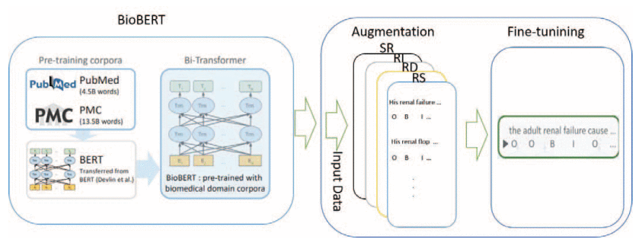
[3]. Issifu, A. M., & Ganiz, M. C. (2021). A simple data augmentation method to improve the performance of named entity recognition models in medical domain. 2021 6th International Conference on Computer Science and Engineering (UBMK). https://doi.org/10.1109/ubmk52708.2021.9558986
The Problem
Issifu & Ganiz (2021) performed augmentation on medical domain data to improve Named Entity Recognition models.
Approach
They employed 4 basic methods:
Synonym Replacement
Random Insertion
Random Deletion
Random Swap
Outcome
They found that, while it was taxing, NLP albumentation for NER significantly improved model performance.

Slide 8
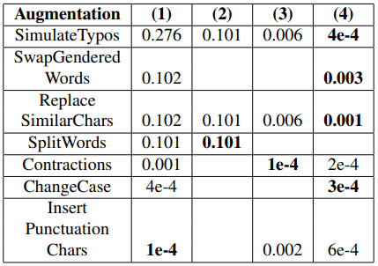
[4]. Papakipos, Z., & Bitton, J. (2022). AugLy: Data augmentations for adversarial robustness. 2022 IEEE/CVF Conference on Computer Vision and Pattern Recognition Workshops (CVPRW). https://doi.org/10.1109/cvprw56347.2022.00027
AugLy, the Text Augmentation Library
Papakipos & Bitton (2022) introduced a text augmentation library (AugLy), as a substitute for existing libraries.
How it Works
AugLy is different from other libraries in that syntactic augmentation prevails over semantic augmentation (i.e., character-level versus word-level) in the package.
This approach to NLP augmentation seeks to replace characters as opposed to words in sentences.
Benchmark Comparisons
AugLy is more robust compared to the already available text augmentation libraries (nlpaug, TextAttack & textflint), a testament that this approach is promising in NLP Albumentation.

Slide 9

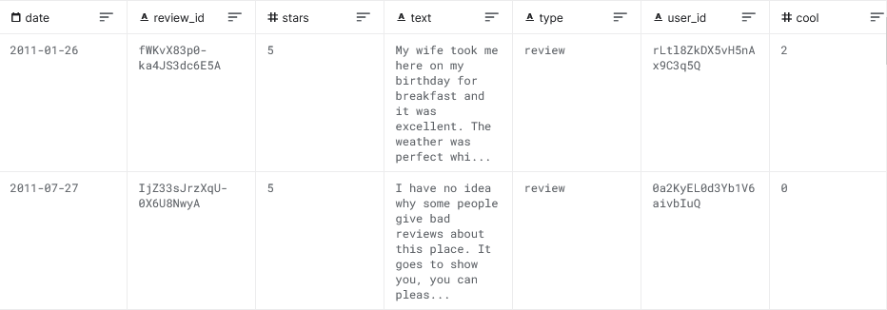
Data Sourcing
Yelp Reviews

Slide 10

What's Next
Data Source Preparation
Select Algorithms/Known Practices for text augmentation
Learn more about under-the-hood process

Slide 11
THANK YOU

